Slide 1
MBTI Type Prediction based on User’s Post
04/16/21 Project Checkpoint 1
CORONIA | LEYESA | LOPEZ

Slide 2
About: Myers-Briggs Type Indicator (Myers, 1962)
A self-reported personality measure
Assigns personality type to the participant based on four “dichotomies”:
Extraversion / Introversion
Sensing / Intuition
Thinking / Feeling
Judging / Perceiving
Letters typically put together to form one’s MBTI type (e.g. ESTJ, INFP)

Slide 3
How do you know your type?
Need to take questionnaire that assigns points for each category/dichotomy
Ouestion: How might we predict someone’s MBTI type without the need for explicit self-reporting, through the way they already write online?
Problem: This is non-trivial through classical ML techniques!
e.g. Baseline Naive Bayes model + count vectorized text performs at about 60% F1 on a single category (E/I)
May need better representations of the text to yield better performance

Slide 4

About: Myers-Briggs Personality Type Dataset
https://www.kaggle.com/datasnaek/mbti-type
Obtained from PersonalityCafe, a personality-based online forum
Notes:
There are 16 unique MBTI types.

Slide 5
About: Myers-Briggs Personality Type Dataset
Contains two (2) columns and 8.6k rows of data.
type: A person’s 4-letter MBTI personality type.
posts: Contains 50 of the person’s most recent posts, separated by “|||”
Posts are raw text -- unprocessed.
Posts truncated at around 200 characters each.
No null/empty rows.
Unbalanced dataset.
Contains emoji in the form :keyword: (Markdown style)
Users quote other users in the form [QUOTE=username;id]
Notes:
There are 16 unique MBTI types.

Slide 6
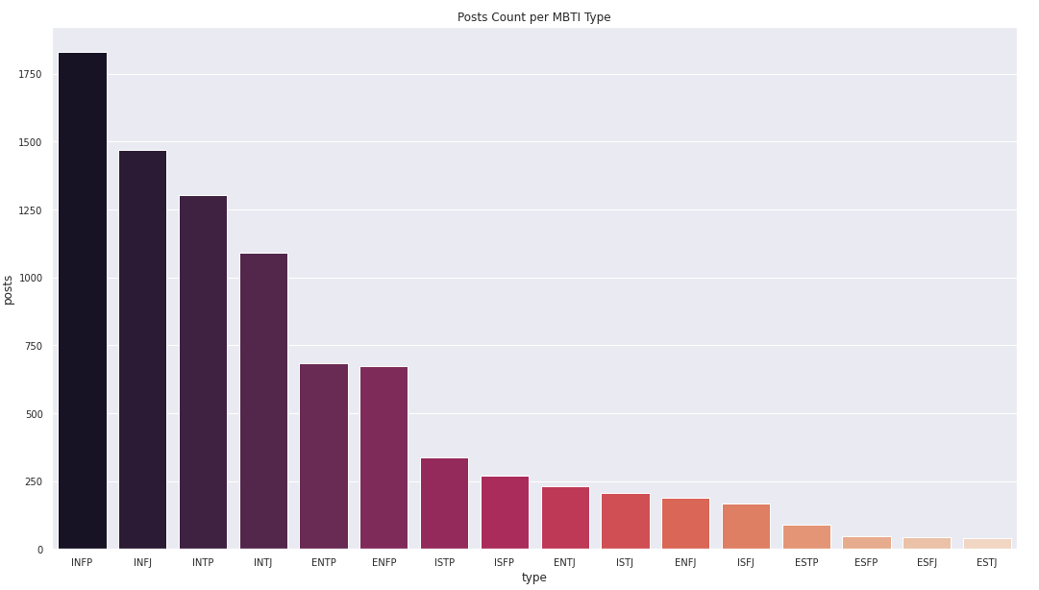
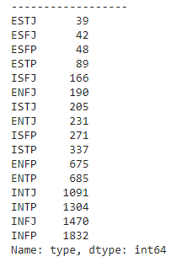
Exploratory Data Analysis
Notes:
Used matplotlib and seaborn, 2 python libraries, for data visualization.
It can be seen that the dataset is skewed towards I-type personality types.
Regarding how to normalize it, one of our members naisipin Data augmentation -- there’s a github implementation of it we can follow and build on top of.

Slide 7
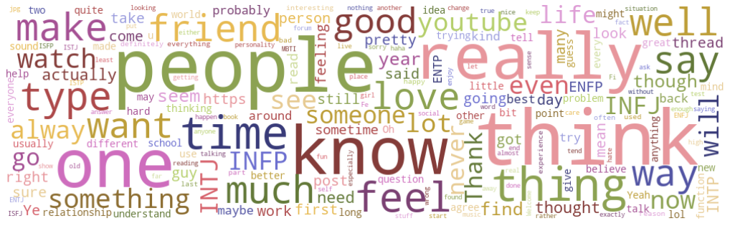
50 Most Frequently Used Words across the entire Dataset (no preprocessing).

Slide 8
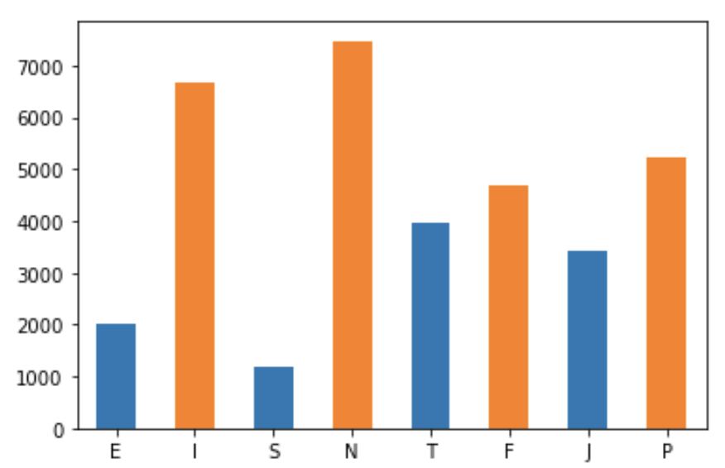
Author frequency per dichotomy
Severe class imbalance between
Extraversion/Introversion
Sensing/Intuition
May require resampling techniques (e.g. random oversampling, SMOTE) to avoid overfitting
Data augmentation also possible (e.g. add/remove tokens)

Slide 9
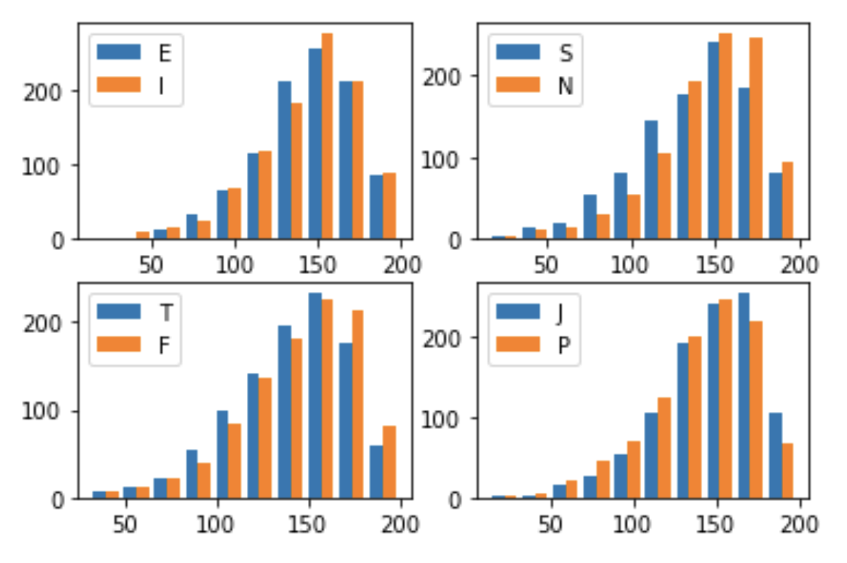
Average post length (characters) per author
At a glance...
Generally left-skewed; authors will tend to write in the 150 character range
Thinking users post shorter than Feeling users
Sensing users post shorter than Intuitive users

Slide 10
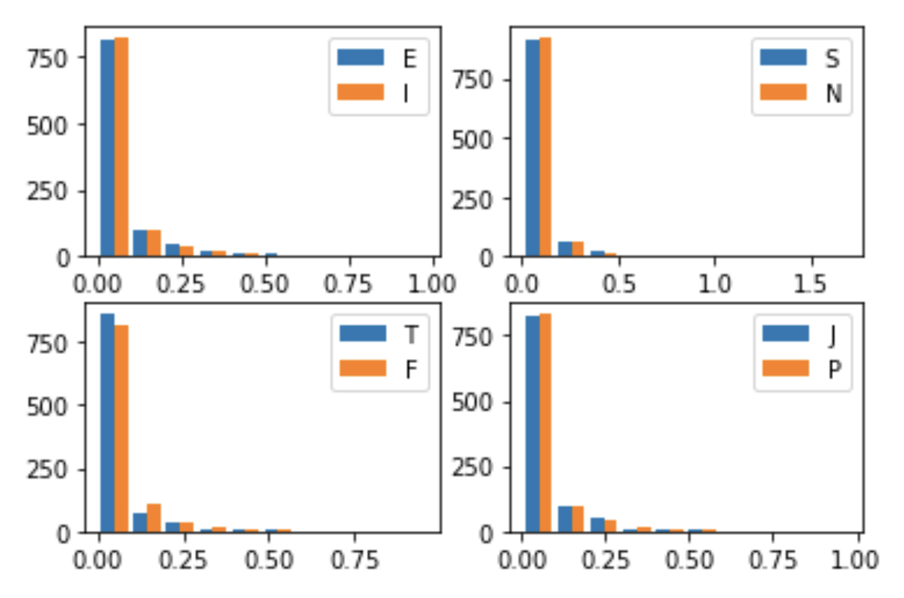
Average emoji frequency per post per author
At a glance...
Thinking authors may use less emoji than Feeling authors
Emoji frequencies per unique emoji type may yield more information for model than aggregate across all emoji types

Slide 11
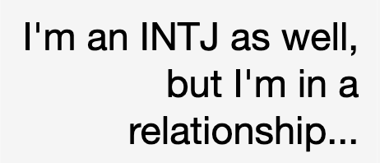
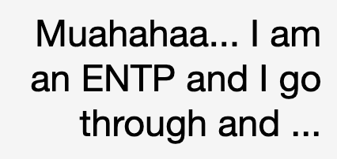
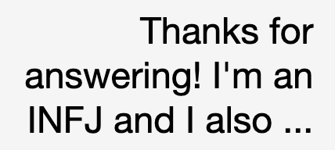
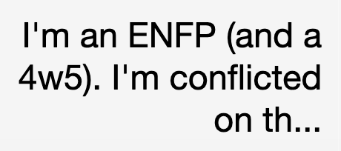
Author behavior: Self-reporting in posts
Authors will occasionally self-report their MBTI type in their own messages
Using a basic regex capturing the pattern “I am/I’m a/an <type>”, we find that:
0.75% of posts contain self-reporting
24.27% of authors have self-reported at least once
However, 17.25% of self-reports are incorrect (don’t match with ground truth MBTI) — not entirely reliable

Slide 12
Author behavior: Self-reporting in posts
Hypothesis: Self-reporting behavior is amplified here due to the nature of the data source (personality-focused forum)
Self-reporting within the text will likely not occur much in a real world setting
During model training, will experiment with/without self-reported type as feature to measure impact on performance

Slide 13
Data Preprocessing
1. Links are removed.
2. End of Sentence characters (EOS) are retained (but changed).
3. Strip punctuation.
4. Remove multiple fullstops.
5. Non-words (incl. emojis) removed.
6. All text is turned into lowercase.
7. Words containing repetitive multiple letters are removed.
8. Remove ANY mention of MBTI Types (see `mbti_type` for full list) in the text.
9. Split by tokenization.
10. Delete stopwords from the list.
11. Lemmatize words.
Notes:
We already did it.

Slide 14
Test Plan
Comparing performance from word embedding-based features vs. traditional text feature extraction techniques (e.g. TF-IDF, additional features from EDA), with classifier model as constant
To use GloVe (Pennington et al., 2014) pretrained word embeddings
Evaluation: Standard classification metrics for imbalanced data (F1, precision/recall) - accuracy**
Classifier
TF-IDF, ...
MBTI Dataset
Word embds
Classifier
Notes:
Used matplotlib and seaborn, 2 python libraries.

